Slide 1
A Kinect-based HMI
HMI: Human-Machine interface

Slide 2
A Kinect-based HMI
How it works?
What are the applications?
How is it applied?
What's the future?

Slide 3
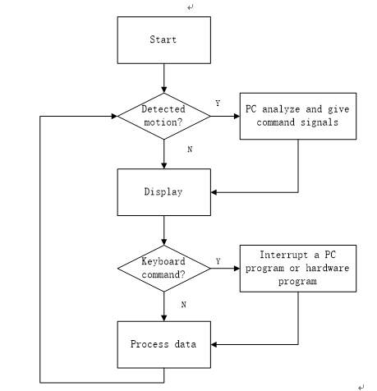
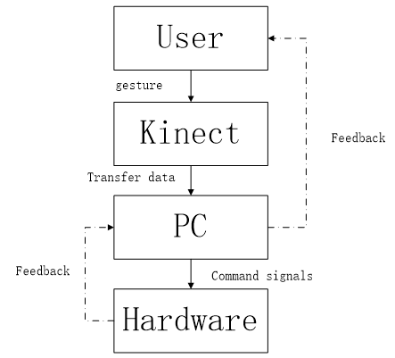
System overview

Slide 4
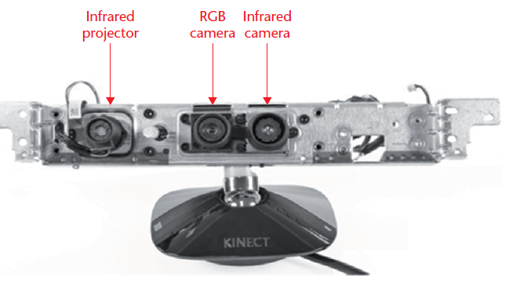
Kinect sensor
A RGB-D Sensor
Depth data of an object can be acquired
Like a single human eye

Slide 5
Ubuntu Linux 14.04 OS
Portable, Free and APIs are defined by IEEE standards
Long Term Support
A rich selection of applications are available

Slide 6
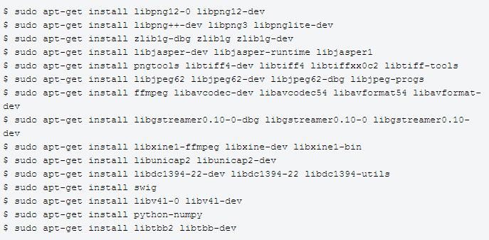
Implementation
Free-Kinect Library
Open NI 1.5.8 Library
source code
IDE & Compilers

Slide 7
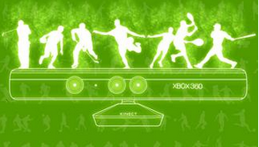
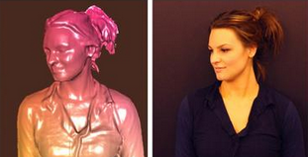
What are the applications?
1.Gaming
2.Gesture Recognition
3.Human Body Natural Interface
4.3D scanning
5.Motion data acquiring

Slide 8
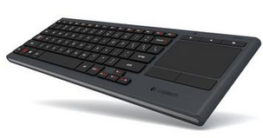
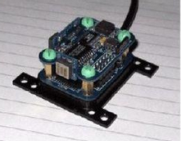
How is it applied?
1.Keyboard
2.Sound Control/ IMU
3.Implementing Algorithms to Define a Gesture and
To Send Signals

Slide 9
User Definition
1.Using Roll Pitch Raw of the head to control a three degree of freedom endoscope.
2.For surgery & medical scenario.
3.A doctor is controlling the whole system, not engineers.

Slide 10
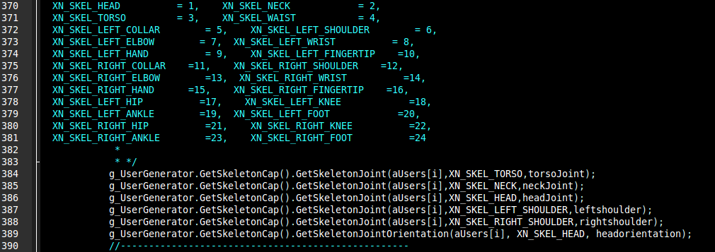
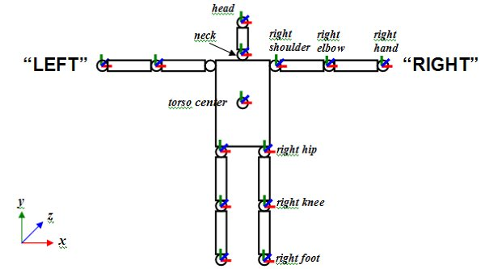
Acquiring data from OpenNI

Slide 11
C/C++ & object orientated programing
Classes and Hierarchical Structure
With the documentation of a previous program, APIs can be used directly for development.
Machine - independent

Slide 12
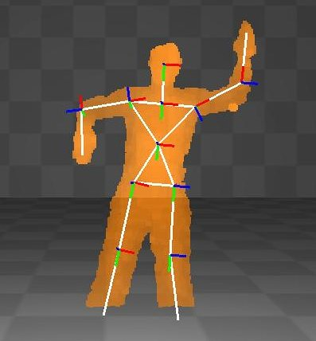
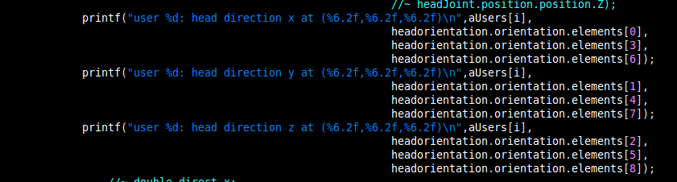
OpenNI:

Slide 13
Algorithm:(To increase the robustness)
0. Filters to get rid of the noises
1.Define a motion by its orientation
2.By its position
3.Creating threshold for comparison
4.Integration of a variable joint subtracting its threshold
5.Detecting the derivative of a joint's position
6.Creating vectors with other joints
7.Creating a logic tree of the above

Slide 14
Selected Elements From Transformation Matrix

Slide 15
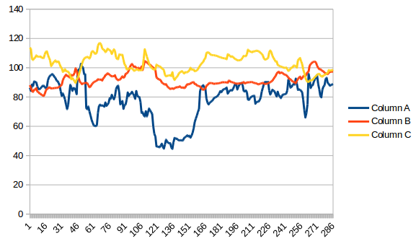
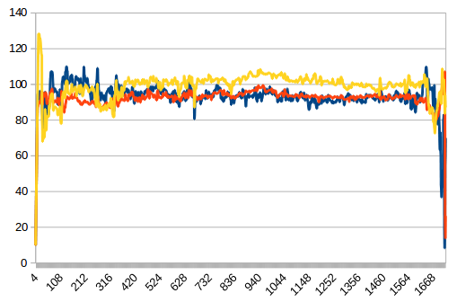
Filters
Without Filters
Filters Added
(Drawback:
Impulse)

Slide 16
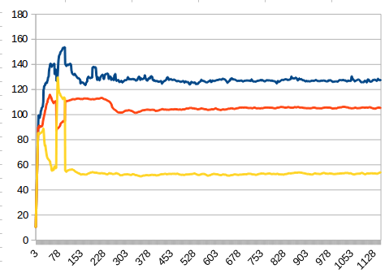
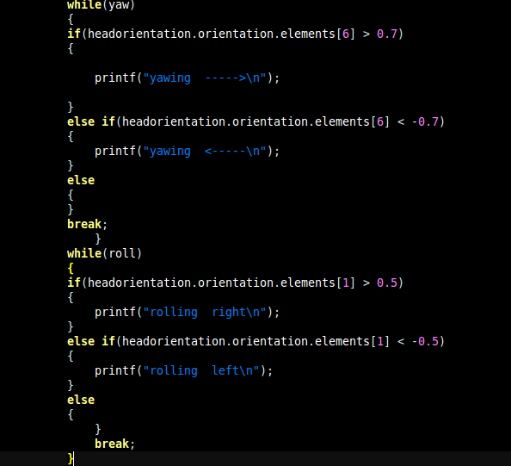
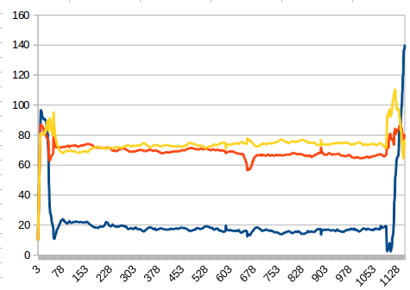
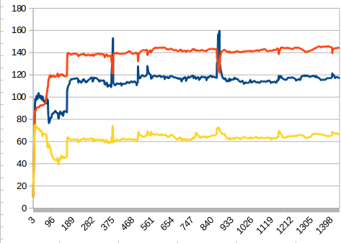
Algorithm: Orientation

Slide 17
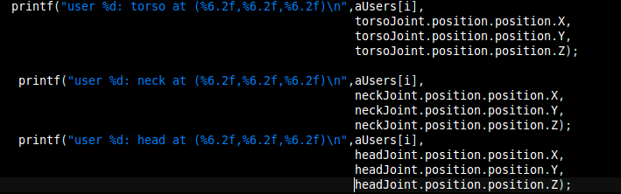
Position and Threshold

Slide 18
Integration of a variable

Slide 19
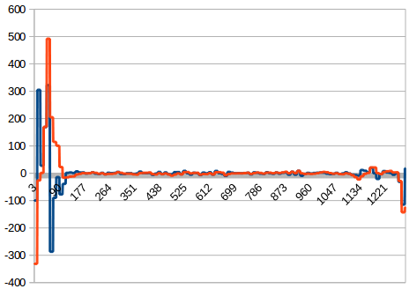
derivative of a joint's position

Slide 20
Creating vectors with other joints

Slide 21
Creating a logic tree of the above

Slide 22
Demonstration

Slide 23
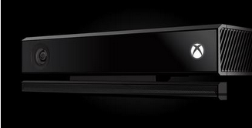
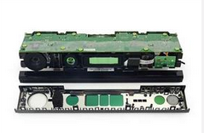
Hardware Upgrade: Kinect-2.0

Slide 24
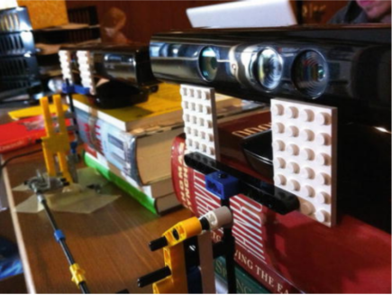
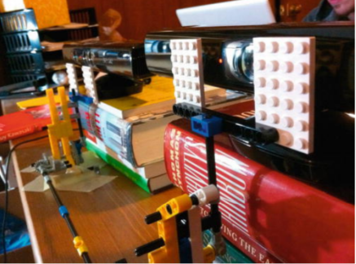
Multiple Kinect

Slide 25
The future of the technology
1.Humanoid
--more detailed motion recording
--related to the control of multi-motors
2.Security
--recognize abnormal motion
--keep record of human information and gives warning
3.Moore's Law
--Hardware would be much smaller
--More compilable to other devices(phones, glasses,etc)
4.Distant Human Robot Interface
--Military
--Global operation

Slide 26
References
C++ Primer 4th edition
C++ How to program 8th edition
A Practical Guide to Ubuntu Linux(3rd Edition)
Hacking the Kinect
RGB-D demo Google group:
https://groups.google.com/forum/#!topic/rgbdemo/WCFZzqT7JFI

Slide 27
Q&A

Slide 28
Thank you very much!

